Slide 1
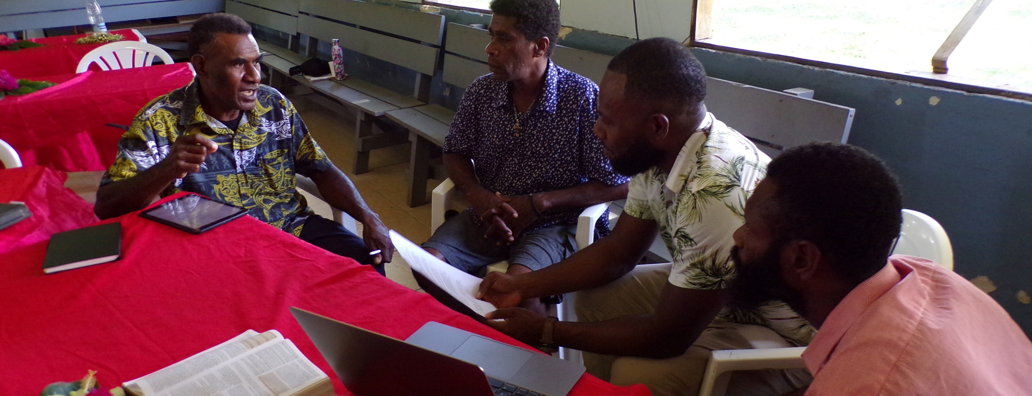
For which of you, intending to build a tower, does not sit down first and count the cost, whether he has enough to finish it – lest, after he has laid the foundation, and is not able to finish, all who see it begin to mock him, saying, “This man began to build and was not able to finish” (Luke 14:28-30).
All Scripture is taken from the New King James Version®. © 1982 by Thomas Nelson, Inc. Used by permission. All rights reserved.
Completion Timeline Strategies

Slide 2
?
Consider

Slide 3
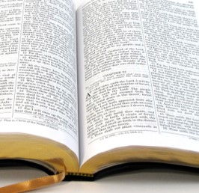
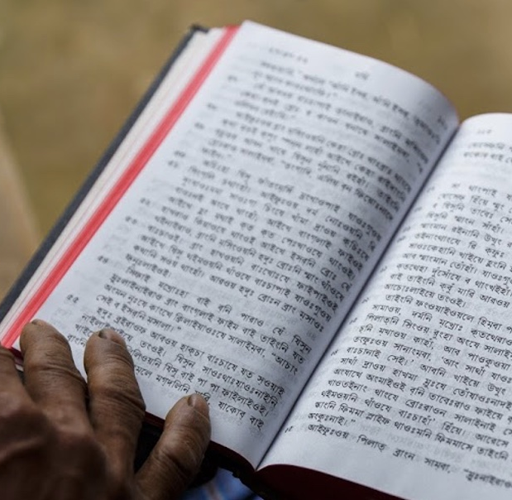
Setting Goals
New Testament: 7,957 verses
6 translators, 25 verses a week, 1 year
Old Testament: 23,145 verses
6 translators, 25 verses a week, 3 years

Slide 4
